Slide 1
Alliterative Verse in Arda
An Oxonmoot 2025 Workshop
Paul D. Deane
Editor, Forgotten Ground Regained

Slide 2
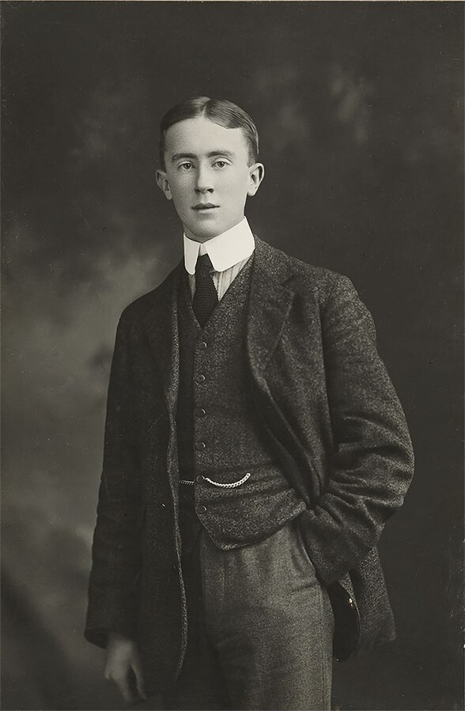
Here’s a young man who wanted to be a poet ….
In 1911, even before he entered college, “Tolkien delighted his friends with recitations from Beowulf, the Pearl, and Sir Gawain and the Green Knight, and recounted horrific episodes from the Norse Völsunga Saga, with a passing jibe at Wagner, whose interpretations of the myths he held in contempt.”
He published several student poems, including the rhyming poem “Goblin Feet”, in Oxford Poetry 2015
In 1915, he also submitted a poetry manuscript, “The Horns of Elfland”, which contained the first seeds of his mythology of Middle Earth.
By 1918 he was working on a long alliterative poem—a precursor to the Silmarillion – entitled, “The Tale of the Children of Hurin”.

Slide 3
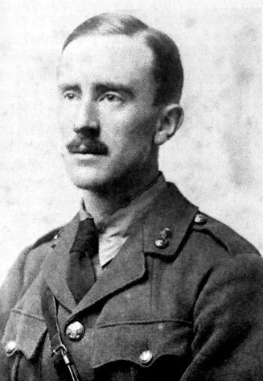
Here’s a soldier who became a scholar ….
He started teaching at Leeds University in 1920, and became the Rawlinson and Bosworth Professor of Anglo-Saxon at Oxford in 1925.
He spent his whole career working on the stories and poems he had loved as a student – Beowulf, Pearl, Sir Gawain and the Green Knight, etc.
All of these poems are in alliterative verse. In effect, he wasn’t just a professor of “Anglo-Saxon” (Old English). He was a professor of alliterative poetry!
His work helped convince people that works like Beowulf are great literature (“The Monster and the Critics”.)

Slide 4
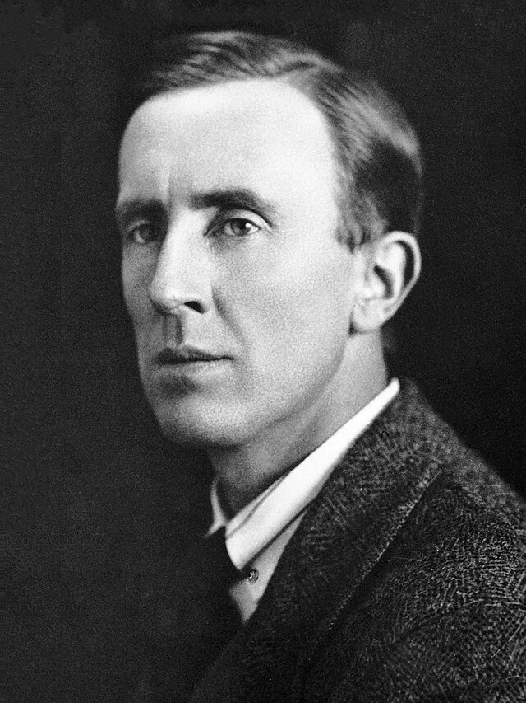
Here’s a professor who became an (accidental) celebrity ….
He wrote The Hobbit for his children. Quite accidentally, it was published and became a bestseller …
He started The Lord of the Rings as a sequel to The Hobbit. Because of who he was, it turned into an epic…
It was quietly published in the mid-1950s. But then it became a Sixties sensation ...
Because of who he was, The Lord of the Rings is chock full of poetry. Including lots of alliterative poetry.
And that’s where we come in …

Slide 5
Tolkien wanted to write the Silmarillion in AV!
Multiple early attempts
Longest:Children of Hurin
Other fragments (Flight of the Noldoli from Valinor, Lay of Leithian, Lay of Earendil)

Slide 6
Internal Evidence: The Elves wrote AV!
In the Lay of Leithian Release from Bondage
In linkèd words has long been wrought
Of Beren Ermabwed, brave, undaunted.
How Lúthien the lissome he loved of yore
In the enchanted forest chained in wonder.
Tinúviel he named her, than nightingale
more sweet her voice, as veiled in soft
and wavering wisps of woven dusk
shot with starlight, with shining eyes
She danced like dreams of drifting sheen,
Pale-twinkling pears in pools of darkness.
-- Fragment of an alliterative Lay of Leithian

Slide 7
Internal Evidence: The Elves wrote AV!
In the Lay of Leithian Release from Bondage
In linkèd words has long been wrought
Of Beren Ermabwed, brave, undaunted.
How Lúthien the lissome he loved of yore
In the enchanted forest chained in wonder.
Tinúviel he named her, than nightingale
more sweet her voice, as veiled in soft
and wavering wisps of woven dusk
shot with starlight, with shining eyes
She danced like dreams of drifting sheen,
Pale-twinkling pearls in pools of darkness.
-- Fragment of an alliterative Lay of Leithian

Slide 8
Internal Evidence: The Elves wrote AV!
From Tolkien’s translation of Sir Gawain and the Green Knight:
“thus linked and truly lettered as it was in this land of old”
In the Lay of Leithian Release from Bondage
In linkèd words has long been wrought
Of Beren Ermabwed, brave, undaunted.
How Lúthien the lissome he loved of yore
In the enchanted forest chained in wonder.
Tinúviel he named her, than nightingale
more sweet her voice, as veiled in soft
and wavering wisps of woven dusk
shot with starlight, with shining eyes
She danced like dreams of drifting sheen,
Pale-twinkling pearls in pools of darkness.
-- Fragment of an alliterative Lay of Leithian

Slide 9
Internal Evidence: The Elves wrote AV!
From Tolkien’s translation of Sir Gawain and the Green Knight:
“thus linked and truly lettered as it was in this land of old”
In the Lay of Leithian Release from Bondage
In linkèd words has long been wrought
Of Beren Ermabwed, brave, undaunted.
How Lúthien the lissome he loved of yore
In the enchanted forest chained in wonder.
Tinúviel he named her, than nightingale
more sweet her voice, as veiled in soft
and wavering wisps of woven dusk
shot with starlight, with shining eyes
She danced like dreams of drifting sheen,
Pale-twinkling pearls in pools of darkness.
-- Fragment of an alliterative Lay of Leithian
From the alliterative Destruction of Troy:
“By locking of letters that left were of old”
.

Slide 10
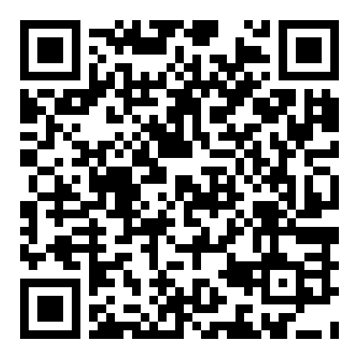
So Tolkien fans have good reason to use AV to write about Tolkien’s world!
I confess to doing so (as you’ll see in the poetry reading session!)
And I am far from the only one. See for instance … Alliterative Verse in Arda.
A great opportunity for new fanworks …

Slide 11
So let’s look at some!
If you’re online, use this QR code, choose one of the poems listed, and read it to yourself.
If you’re in the room, read a few poems from the handout.
You have six minutes.
Note: you will get more out of the reading if you (quietly) read it to yourself out loud …
When the six minutes are up, be prepared to volunteer your answers to a few questions …

Slide 12
Now, read!

Slide 13
Questions
Did this read like poetry to you? Why or why not?
Rythmically, how is this different from metrical poetry? From free verse?
What struck you when you read this kind of poetry out loud?
How well, do you think, the authors of these fanfic poems did, using alliterative verse to tell stories set in Tolkien’s world?

Slide 14
A Quick Introduction to Alliterative Verse

Slide 15
C.S. Lewis’ Teaching Example
We were talking of DRAGONS, Tolkien and I
In a Berkshire bar. The big workman
Who had sat silent and sucked his pipe
All the evening, from his empty mug
With gleaming eye glanced towards us:
"I seen 'em myself!" he said fiercely.

Slide 16
Half-Lines: Alliterative Verse is built from PHRASES
We were talking of DRAGONS,
Tolkien and I
In a Berkshire bar.
The big workman
Who had sat silent
and sucked his pipe
All the evening,
from his empty mug
With gleaming eye
glanced towards us:
"I seen 'em myself!"
he said fiercely.

Slide 17
LIFTS and DIPS: 2 each per half line
We were talking of DRAGONS, Tolkien and I
In a Berkshire bar. The big workman
Who had sat silent and sucked his pipe
All the evening, from his empty mug
With gleaming eye glanced towards us:
"I seen 'em myself!“ he said fiercely.

Slide 18
Four possible rhythms
Falling-Falling (Type A):
(all the evening, glanced towards us)
Rising-Rising (Type B):
(in a Berkshire Bar, with gleaming eye)
Rising-Falling (Type C):
(the big workman, he said fiercely)
Falling-Rising (Types D and E):
(Tolkien and I)
Notes:
In falling-rising rhythm, one of the syllables in the dip has to be stronger than the other, i.e., have secondary stress (for instance –ien in Tolkien compared to and), or you can’t get two dips in a row. The difference between types D and E is where that secondary stress falls.

Slide 19
Alliteration
We were talking of DRAGONS, Tolkien and I
In a Berkshire bar. The big workman
Who had sat silent and sucked his pipe
All the evening, from his empty mug
With gleaming eye glanced towards us:
"I seen 'em myself!" he said fiercely.

Slide 20
Alliteration
We were talking of DRAGONS, Tolkien and I
In a Berkshire bar. The big workman
Who had sat silent and sucked his pipe
All the evening, from his empty mug
With gleaming eye glanced towards us:
"I seen 'em myself!" he said fiercely.
One or both lifts in the first half line must alliterate

Slide 21
Alliteration
We were talking of DRAGONS, Tolkien and I
In a Berkshire bar. The big workman
Who had sat silent and sucked his pipe
All the evening, from his empty mug
With gleaming eye glanced towards us:
"I seen 'em myself!" he said fiercely.
The first lift in the second half line MUST alliterate

Slide 22
Alliteration
We were talking of DRAGONS, Tolkien and I
In a Berkshire bar. The big workman
Who had sat silent and sucked his pipe
All the evening, from his empty mug
With gleaming eye glanced towards us:
"I seen 'em myself!" he said fiercely.
The last lift in the second half line MUST NOT alliterate

Slide 23
Rules for Alliteration
1. Only the stressed syllables of a word count.
(For example, “delight” alliterates on l, not d.)
2. Vowels alliterate with other vowels.
(For example: all the evening.)
3. Sp-, st- and sk-/sc- are treated as distinct
consonants. They don’t alliterate with s or
with one another.

Slide 24
Advantages of Alliterative Verse
Alliterative verse rhythms are very free. That’s something
people used to writing free verse should appreciate!
2. But the alliteration creates an audible rhythm, anyway. It’s like
the bass line in jazz, marking the beat.
3. It’s much easier to find words that alliterate than words that
rhyme. Alliterative verse fits the natural patterns of the
language; rhyming poetry was borrowed from Romance
languages (Latin and French), where it’s significantly easier to
rhyme.
4. So alliterative verse offers the best of both worlds: a musical beat in the
background, as in formal, metrical verse, with great rhythmic freedom,
as in free verse.

Slide 25
Caveats
1. The rules I have gone over are the rules for OLD ENGLISH
alliterative verse. Middle English (or Norse/Icelandic)
alliterative verse had slightly different rules.
2. When people write modern English alliterative verse, they
don’t always follow all of these rules either.
3. Sometimes they’ve even thrown away the rules and invented
their own original alliterative form (I did that in my poem cycle,
“Tales of the Avari”.)
4.But if you understand the basic principles, you’re likely to write
better alliterative verse of your own.

Slide 26
Time for Some Tolkien Fan Poetry Readings!

